Slide 1
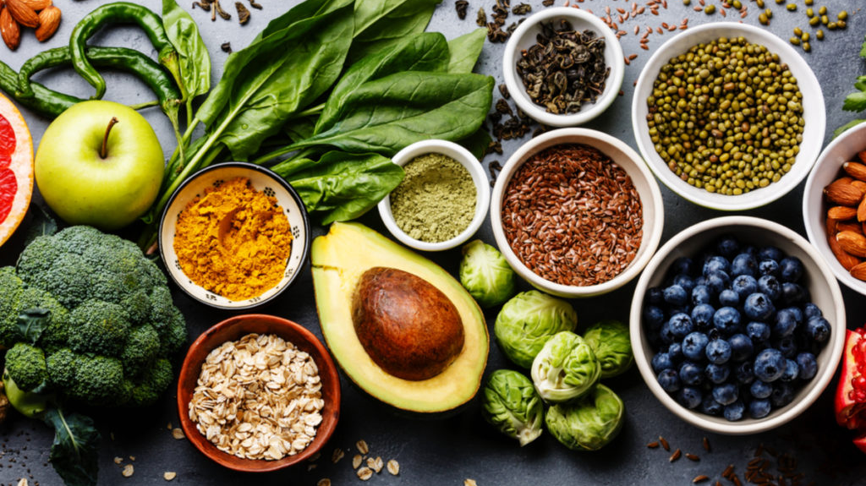
Feed Me
By Christopher Perez
Advisor: Dr. Grabowski

Slide 2

Problem
Time-consuming
Manual
Not personalized

Slide 3



Existing Solutions
Limited personalization
Manual effort required
Subscription fatigue

Slide 4
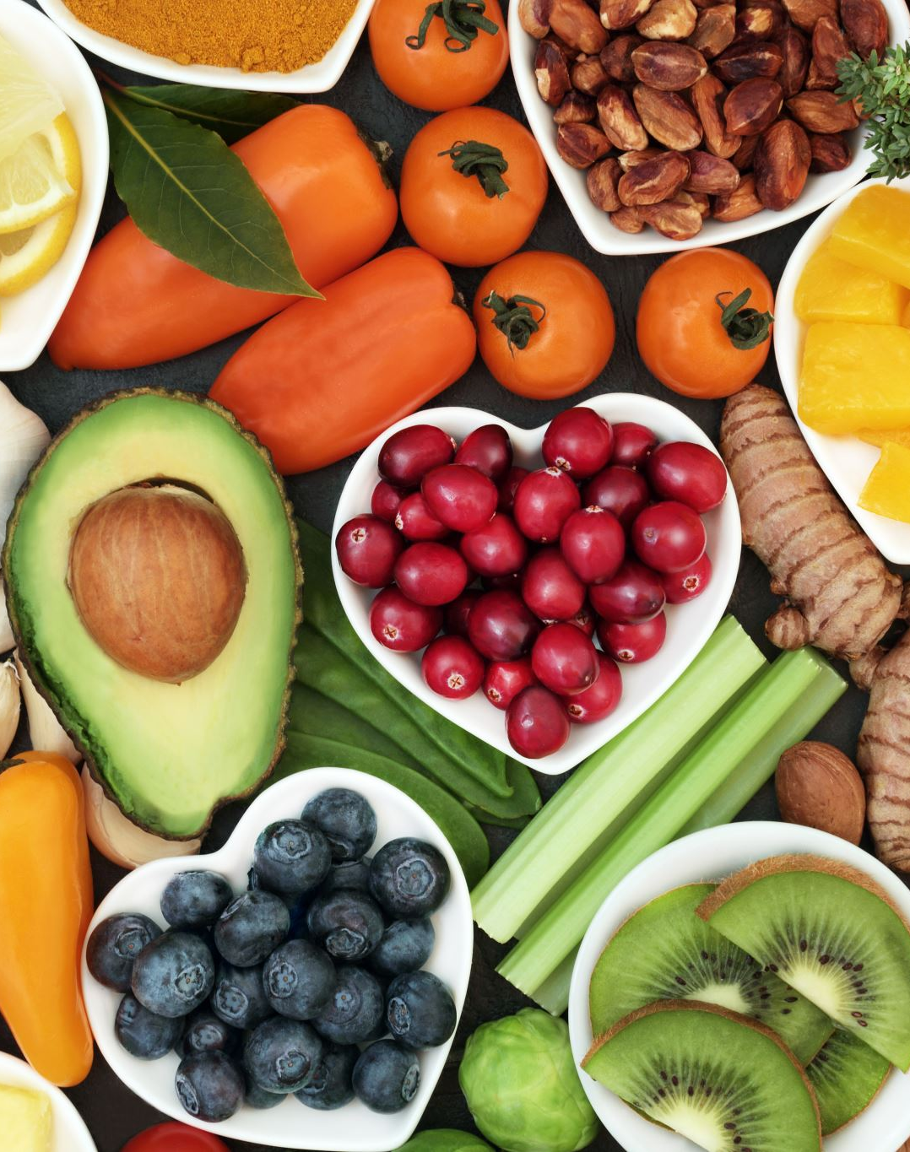
Feed Me
Automated meal planning
Instant grocery lists
Nutrition insights & recipes
Fast setup (no account, minimal input)

Slide 5

How It Works
User selects preferences
Frontend sends request
Backend generates plan
Returns meals and grocery list

Slide 6
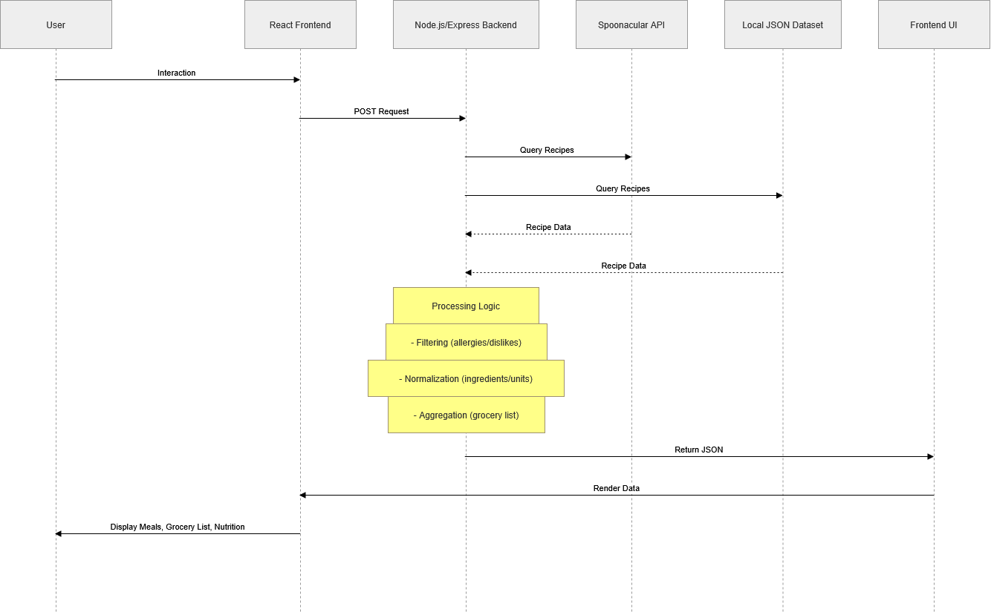

Slide 11

Live Demo

Slide 12
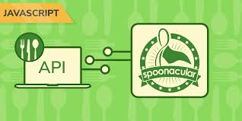
API Limits & Data Reliability
External API has rate limits
Implemented local fallback support
Ensured consistent data availability

Slide 13
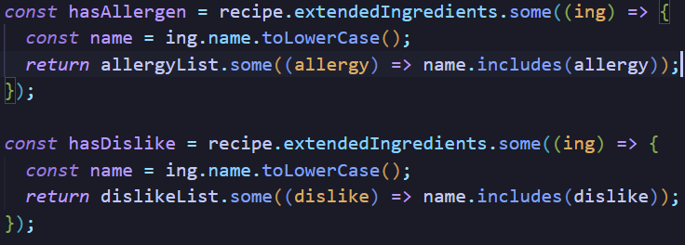
Filtering Allergies & Preferences
Expanded allergy terms (e.g., “nuts” -> specific ingredients)
Filtered recipes before selection
Ensured safe meal recommendations

Slide 14
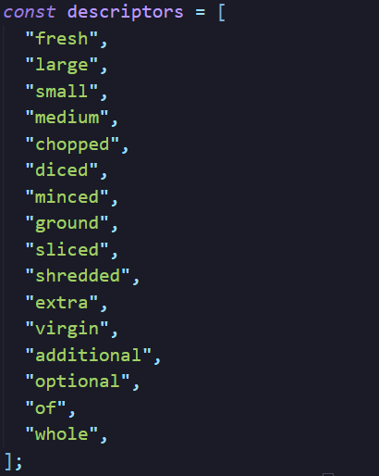
Handling Ingredient Inconsistencies
Cleaned ingredient names
Removed descriptors (“fresh”, “chopped”, etc)
Standardized units

Slide 15
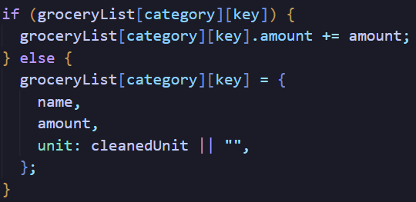
Building a Clean Grocery List
Combined duplicate ingredients
Summed quantities across meals
Organized by category

Slide 16

User Feedback
Positive Feedback
  Easy to use
  Saves time
Constructive Feedback
  Want more customization
  Improvement on UI

Slide 17

Conclusion
Built a full-stack meal planning application
Focused on speed, simplicity, and usability
Ready for future expansion

